Slide 1
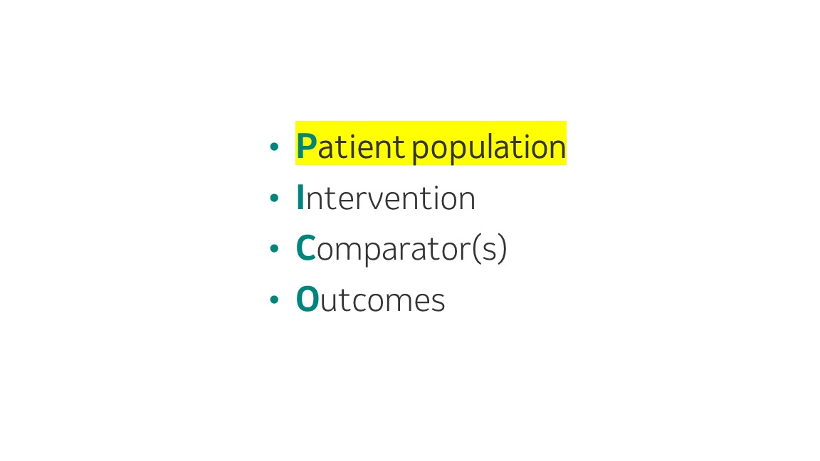
All PICOs Great and Small
Dealing with small subpopulations in the EU HTA landscape
15th June 2026
Dave Gelb, Joel Baldwin, Ehsan Masoudi, Milana Ivkovic, Lovisa Berggren, Larry Leon

Slide 2
Agenda
Background and Context; EU HTA, subpopulations
Problem statement
Related guidance and literature
Proposed Solution
Discussion

Slide 3
Context: The EU HTA Regulation - effective January 2025 Assessment Scope for Joint Clinical Assessment→ PICOs
The mandatory requirement of centralised clinical assessment for patient access of new health technologies to MS of the EU
The assessment scope should include all relevant parameters in terms of the PICO framework:
Patient population
Intervention
Comparator(s)
Outcomes
PICO selection is policy-driven, not evidence-driven.
EU Member States determine their PICO needs, which is followed by a consolidation of PICOs
EU, European Union; JCA, Joint Clinical Assessment; MS, Member State; PICO, Population, Intervention, Comparator(s), Outcomes.

Slide 4
Subpopulations – the ‘P’ of the PICO
Target approval population(s)
May be defined by baseline characteristic(s), disease characteristic(s), biomarker(s),…
Sponsors required to provide full analysis & reporting package for efficacy, PROs, safety
Conceptually subpopulations ≠ subgroups
Also need to provide subgroups within sub-populations

Slide 5
Small subpopulations - Context, Issue and Motivation
What happens when we have to address a ‘small’ subpopulation?
When it comes to statistical analyses, can we ‘just say no’?
Do we have any statistical grounds to push back – i.e. not analyse, instead provide descriptive summaries?
Is it realistic to have a consistent, accepted approach within an organisation?
Across organisations?

Slide 6
Little literature or guidance on small sub-populations
Guidelines
German IQWIG ‘80% rule’
(If sub-population is ≥80% of whole study population, can use the latter)
Literature Review Results
Citation: Brookes, S.T., Whitley, E., Peters, T.J., Mulheran, P.A., Egger, M., & Davey Smith, G. (2001). Subgroup analyses in randomised controlled trials: quantifying the risks of false-positives and false-negatives. Health Technology Assessment, 5(33), 1–56.
Key Findings: This foundational HTA-focused paper demonstrated through simulation that subgroup analyses in RCTs carry a high risk of false-positives when sample sizes are small, especially when multiple subgroups are examined. The authors showed that underpowered subgroup analyses can produce spurious treatment heterogeneity and that the risks increase sharply as subgroup sample size decreases. The paper called for pre-specification and formal interaction testing as minimum standards.
Citation: Beca, J., Perampaladas, K., Goeree, R., & Xie, F. (2021). Impact of limited sample size and follow-up on single event survival extrapolation for health technology assessment: a simulation study. BMC Medical Research Methodology, 21, 282.
Key Findings: Simulation study directly addressing HTA survival analysis in small samples. Simulated populations of 50,000 with exponential hazard rates; drew samples of 30–500 patients across 5,000 repetitions and fitted six parametric distributions. Demonstrated that small samples produce large estimation errors and that CI uncertainty may be severely underestimated, with significant implications for HTA decision modelling. CI coverage was poor when sample sizes were small.
Citation: Murray, T.A., Thall, P.F., Yuan, Y., McAvoy, S., & Gomez, D.R. (2017). Robust treatment comparison based on utilities of semi-competing risks in non-small-cell lung cancer. Journal of the American Statistical Association, 112(517), 11–23.
Key Findings: Simulation-based evaluation of estimation variability in small oncology trial samples, demonstrating that point estimates and CI limits are highly unstable when N is small in survival endpoints. Highlights the importance of quantifying this instability through Monte Carlo methods.

Slide 7
The Central Question
A central question in any trial with subgroup analyses is whether an apparent finding reflects genuine heterogeneity or is noise amplified by small sample size.
Key challenge:
Small subgroups can produce dramatic-looking hazard ratio estimates purely by chance. A reviewer seeing UB(HR) = 3.5 in a 15-patient subgroup cannot distinguish this from a genuine safety signal without calibration.
Core insight:
Clinical subgroups of a given N are statistically indistinguishable from meaningless random groupings of the same size. Clinical rationale provides no statistical protection against sampling noise.

Slide 8
Strategy: Simulation-Based Calibration
This paradigm uses the trial data itself — observed outcomes, censoring process, and individual covariates — to construct a realistic simulation framework.
Pipeline:
Fit a Weibull AFT model to observed trial data to build a data-generating mechanism (DGM)
Calibrate the censoring distribution to match the observed censoring rate
Generate thousands of synthetic trials under a uniform (null) treatment effect
Analyse each synthetic trial across dozens of pre-specified subgroups via Cox regression
Characterise the distribution of chance findings: HR point estimates, upper confidence bounds
The DGM preserves the trial’s covariate distributions, correlation structure, and censoring patterns.

Slide 9
Source Data: GBSG Breast Cancer Trial
The German Breast Cancer Study Group (GBSG) dataset provides the foundation for the simulation.
N = 686 patients with primary node-positive breast cancer
Endpoint: recurrence-free survival time
Treatment: hormonal therapy vs. control
Covariates for subgroup definitions:
Age, menopausal status, tumour size, number of positive nodes, tumour grade, progesterone receptor (PGR), estrogen receptor (ER)
56 subgroups evaluated per trial: ITT (1), clinical (4), continuous cut-points (13), two-way interactions (29), three-way (5), and 4 random benchmarks (N ≈ 15, 20, 40, 60).

Slide 10
The Uniform Treatment Effect DGM
The DGM enforces a perfectly uniform treatment benefit:
True HR = 0.70 for every patient, regardless of covariate profile.
Any apparent subgroup heterogeneity is a false positive by construction.
Random benchmark subgroups (random60, random40, random20, random15) are created by randomly sampling subjects each simulation. These have no clinical meaning — their true HR is exactly 0.70 — and serve as size-matched null controls.
Each simulation generates a synthetic RCT (N = 686), fits a stratified Cox model in all 56 subgroups, and records the HR point estimate and the upper bound of the 95% CI.

Slide 11
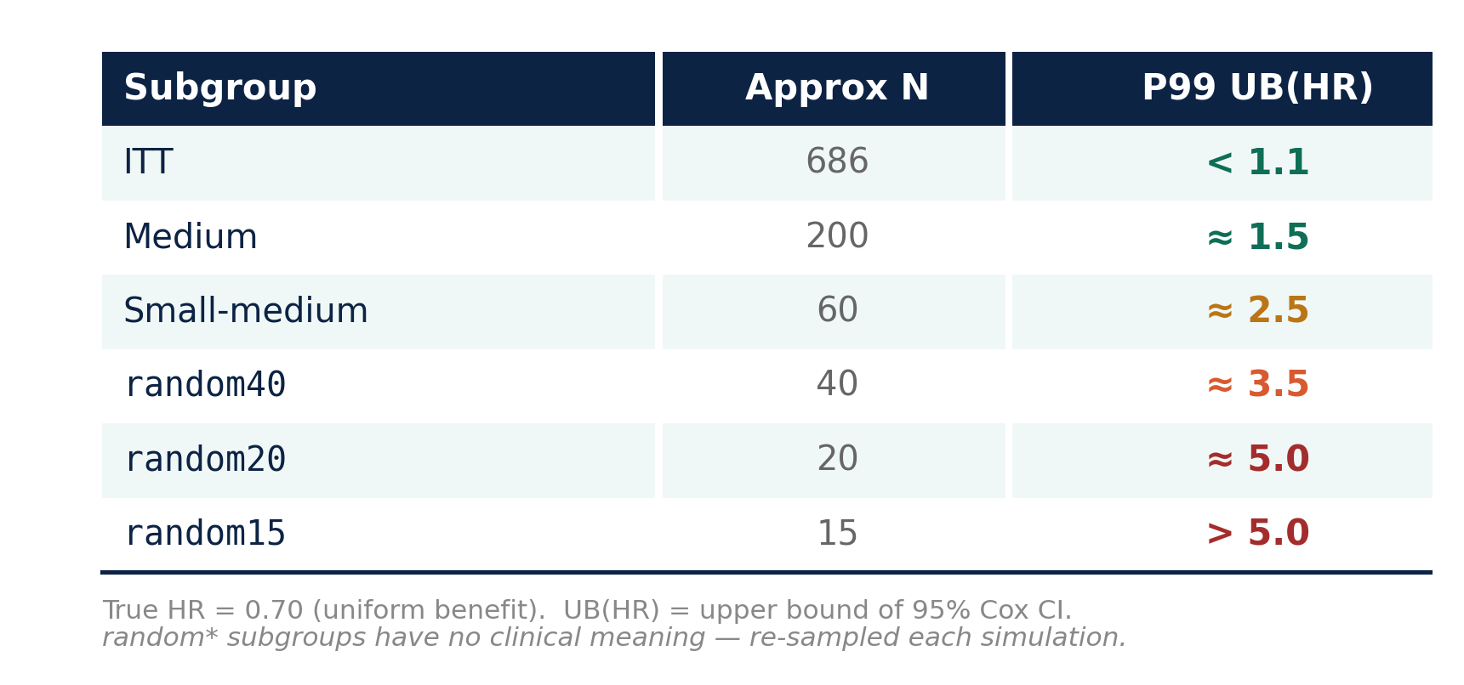
What Chance Alone Produces
The Cox model is unbiased (median HR ≈ 0.70 everywhere) with correct CI coverage. Wide intervals in small subgroups accurately reflect genuine statistical uncertainty.

Slide 12
Interpreting Subgroup Findings Against Chance
These benchmarks directly inform interpretation: before concluding that a finding is real, compare it against what chance alone produces for a subgroup of the same size.
Practical calibration question:
“Is this subgroup result more extreme than what I would expect from a random grouping of the same size?” If not, the result is fully consistent with chance.
For random subgroups of N ≈ 15–20, UB(HR) routinely exceeds 3.0–5.0 in the worst 1% of trials — despite a true HR of 0.70 (substantial benefit).
Clinically motivated subgroups of the same size show identical variability. Simulation-based calibration is essential for honest, transparent assessment.
The framework is designed so analysts can swap in their own trial data for the GBSG example. The pipeline — DGM construction, censoring calibration, trial generation, subgroup analysis — is fully general.

Slide 13
Conclusion & Resources
Key takeaways:
Small subgroups produce extreme results by chance alone
Clinical rationale does not protect against sampling noise
Simulation-based calibration quantifies how “extreme” a result truly is
The forestsearch R package provides a complete, reproducible workflow
Extreme Subgroups vignette and full documentation:
https://larry-leon.github.io/forestsearch/
Install: pak::pak("larry-leon/forestsearch")

Slide 14
So what?
Well Dave…

Slide 15
Some considerations and limitations of our work on handling small PICOs
Any guidance around ‘how small is too small to analyse?’ is inherently arbitrary
We chose a particular approach & provide some statistical justification
We focus on upper bounds of 95% Cis
Quantify risk of large upper bounds suggesting concern, despite real benefit
Simulation code (created by Larry Leon) available on GitHub
Balance statistical rigour vs. being competitive
We still want to seek approvals, what are other sponsors doing?
Future work includes:
How to handle AE SOCs and PTs
Guidance for small indirect treatment comparisons PICOs
Notes:
Metric(s) used (e.g. sample size, retrospective power calculation, etc.)
Cut-off point (N=20/arm, power of 50%, etc.)

Slide 16
Appendix

Slide 17
Terminology examples
Sub-populations
For a Keytruda study => patients with PD-L1 > 50, when study inclusion criteria may be PD-L1 >1
For a study with standard of care arm of investigator’s choice of treatment => patients pre-assigned by investigator prior to randomization, to one particular treatment, should they be randomized to the SoC arm
Subgroups
Age (<65 vs. ≥ 65), sex (female vs. male), baseline disease severity (moderate vs. severe),…
Restricted label population
Patients with unresectable or metastatic cancer; pivotal trial included patients with locally advanced disease (typically may be based on subgroup results).

Slide 18
Inadvertent subgroup unblinding
Example:
Country A requested primary endpoint results split by age ≥65 and age <65
Country B requested primary endpoint results split by age ≥75 and age <75
Results for participants aged 65 – 75 could be inferred
----
Cannot expect individual countries to submit such information pro-actively
Within BARDS HTA Statistics we could say to an individual country affiliate that we will provide them with the complementary sub-population. It is their decision on how to handle.
Need to consider which analyses should be pro-active vs. reactive

Slide 19
Acknowledgements
Dom Muston, Jon Hartzel, Justin Chumbley, Kristel Vandormael, Lara Wolfson, Lidia Mukina, Mayur Amonkar, Patrick Moneuse, Ruixuan Jiang, Sabrina Wan, Shahrul Mt-Isa

